Slide 1

Java Concurrency
Dima Ionut Daniel

Slide 2
Contents
What is Java?
History
Java Flavors
Concurrency Concepts
Java Concurrency
Design Patterns
Testing and Monitoring
Bibliography

Slide 3

What is Java?
Java is a programming language created by Sun Microsystems.
Java is used in a wide variety of computing platforms from embedded devices and mobile phones on the low end, to enterprise servers and supercomputers on the high end.
Java eliminates certain low-level constructs such as pointers and has a very simple memory model where every object is allocated on the heap and all variables of object types are references.
Memory management is handled through integrated automatic garbage collection performed by the JVM.

Slide 4
What is Java? (cont.)
The heart of the Java platform is the concept of a "virtual machine" that executes Java bytecode programs. This bytecode is the same no matter what hardware or operating system the program is running under.
There is a JIT(Just-In-Time) compiler within the Java Virtual Machine, or JVM. The JIT compiler translates the Java bytecode into native processor instructions at run-time and caches the native code in memory during execution. The use of a JIT compiler means that Java applications, after a short delay during loading and once they have "warmed up" by being all or mostly JIT-compiled, tend to run about as fast as native programs.
The Java programs are cross-platform or platform independent, but the code of the Java Virtual Machines (JVM) that execute these programs is not.

Slide 5
History
The initial Java release was named Oak, and the first stable version was JDK 1.0.2, called Java 1.
JDK 1.0 - 23 January 1996
JDK 1.1 – 19 February 1997
J2SE 1.2 – 8 December 1998 (codename Playground)
J2SE 1.3 – 8 May 2000 (codename Kestrel)
J2SE 1.4 – 6 February 2002 (codename Merlin)
J2SE 5.0 – 30 September 2004 (codename Tiger)
Java SE 6 – 11 December 2006 (codename Mustang)
Java SE 7 – 7 July 2011(codename Dolphin)
Java SE 8 – 18 March 2014 (codename Spider)
Java SE 9 – planned for 2016

Slide 6
Java Flavors
The Java distribution comes in different flavors:
Java Card →run securely on smart cards and similar small-memory devices.
Java ME(Micro Edition) → Specifies several different sets of libraries (known as profiles) for devices with limited storage, display, and power capacities.
Java SE(Standard Edition) → for general-purpose use on desktop PCs, servers and similar devices.
Java EE(Enterprise Edition) → Java SE plus various APIs useful for multi-tier client–server enterprise applications.

Slide 7
Conccurency Concepts
Concurrent programming includes all the tools and techniques to have multiple tasks or processes running at the same time in a computer.
Concurrency and parallelism are very similar concepts.
We can discuss about parallelism when we have more than one task that runs simultaneously in the system.
There are different techniques and mechanisms how to synchronize tasks and their access to shared resources.

Slide 8
Conccurency Concepts (cont.)
In concurrency, we can define synchronization as the coordination of 2 or more tasks to get the desired results:
Control synchronization: one task depends on the end of another task, the second task can’t start before the first has finished.
Data access synchronization: 2 or more tasks have access to a shared variable and only one of the tasks can access the variable at any given time.

Slide 9
Conccurency Concepts (cont.)
A concept closely related to synchronization is critical section.
A critical section is a piece of code that can be only executed by a task at any given time because of its access to a shared resource.
Mutual exclusion is the mechanism used to guarantee this requirement and can be implemented by different ways.

Slide 10
Conccurency Concepts (cont.)
We need to calculate very carefully the number of tasks, which can be performed independently without intercommunication in your parallel algorithm.
Coarse-grained granularity = big tasks with low intercommunication
Fine-grained granularity = small tasks with high intercommunication

Slide 11
Conccurency Concepts (cont.)
Common synchronization algorithms:
Semaphore:
can be used to control the access to one or more resources.
a mutex(mutual exclusion) is a type of semaphore that can have 2 values (free, busy) and only the process that sets the mutex to busy can release it.
Monitor:
is a mechanism to get mutual exclusion over a shared resource.
has a mutex, a condition variable and 2 operations to wait for the condition and to signal the condition.

Slide 12
Conccurency Concepts (cont.)
A piece of code (or a method, object) is thread-safe if all the users of shared data are protected by synchronization mechanisms or data is immutable, a nonblocking compare-and-swap(CAS) primitive.
An immutable object is an object that we can't modify its visible state after its initialization.
If we want to modify and immutable object we need to create a new one.
Its main advantage is that it is thread-safe.

Slide 13
Conccurency Concepts (cont.)
An atomic operation is a type of operation that appears to occur instantaneously to the rest of the tasks of the program.
An atomic variable is a kind of variable with atomic operations to set and get its value.
We can have a data race (also named race condition) in the application when we have two or more tasks writing a shared variable outside a critical section, without using any synchronization mechanisms.

Slide 14
Conccurency Concepts (cont.)
A deadlock occurs when there are two or more tasks waiting for a shared resource that must be free from the other.
So none of them will get the resources they need and will be blocked indefinitely.
They are Coffman’s conditions:
Mutual exclusion:
resources involved in the deadlock must be nonshareable
only one task can use the resource at a time.

Slide 15
Conccurency Concepts (cont.)
Hold and wait condition:
a task has the mutual exclusion for a resource and it’s requesting the mutual exclusion for another resource.
while it’s waiting, it doesn’t release any resources.
No pre-emption:
the resources can only be released by the tasks that hold them.
Circular wait:
there is a circular waiting where Task 1 is waiting for a resource that is being held by Task 2, which is waiting for a resource being held by Task 3, and so on until we have Task n that is waiting for a resource being held by Task 1.

Slide 16
Conccurency Concepts (cont.)
A livelock occurs when we have two tasks in the systems that are always changing their states due to the actions of the other. Consequently, they are in a loop of state changes and unable to continue.
Example:
We have two tasks—Task 1 and Task 2—and both need two resources: Resource 1 and Resource 2.
Suppose that Task 1 has a lock on Resource 1, and Task 2 has a lock on Resource 2.
As they are unable to gain access to the resource they need, they free their resources and begin the cycle again.

Slide 17
Conccurency Concepts (cont.)
Resource starvation occurs when you have a task in your system that never gets a resource that it needs to continue with its execution.
Fairness is the solution to this problem.
All the tasks that are waiting for a resource must have the resource in a given period of time.
An option is to implement an algorithm that takes into account the time that a task has been waiting for a resource when it chooses the next task that will hold a resource.
Priority inversion occurs when a low-priority task holds a resource that is needed by a high-priority task, so the low-priority task finishes its execution before the high-priority task.

Slide 18
Conccurency Concepts (cont.)
How to design concurrent algorithms:
1)analysis
2)design: we have 2 approaches:
Task decomposition: split code into mode independent tasks to be executed.
Data decomposition: multiple tasks are using subset of the dataset (shared resource).
3)implementation
4)testing: a bit complex as the order of the execution of the different tasks is not guaranteed.
5)tuning: compare the throughput the parallel/sequential algorithms.

Slide 19
Java Conccurency
Java contains clases to manage concurrency: Thread, Lock, Semaphore.
It contains classes that implement very high-level synchronization mechanisms, such as the executor framework or the new parallel Stream API.

Slide 20
Java Conccurency (cont.)
The synchronized keyword:
allows you to define a critical section in a block of code or in an entire method.
The Lock interface:
provides a more flexible synchronization operation than the synchronized keyword.
types of Locks:
ReentrantLock is a Lock that can be associated with a condition;
ReentrantReadWriteLock separates read and write operations;
StampedLock is a new feature of Java 8 that includes three modes for controlling read/write access.

Slide 21
Java Conccurency (cont.)
The Semaphore class:
it implements the classical semaphore to implement synchronization.
The CountDownLatch class:
class that allows a task to wait for the finalization of multiple operations.
The CyclicBarrier class:
class that allows the synchronization of multiple threads in a common point.
The Phaser class:
class that allows to control the execution of tasks divided into phases.
none of the tasks advance to the next phase until all of the tasks have finished the current phase.

Slide 22
Java Conccurency (cont.)
The executor framework is a mechanism that allows you to separate thread creation and management for the implementation of concurrent tasks.
The Executor and ExecutorService interface:
include methods common to all executors.
ThreadPoolExecutor:
allows to get an executor with a pool of threads and optionally define a maximum number of parallel tasks
ScheduledThreadPoolExecutor:
is a special kind of executor to allow to execute tasks after a delay or periodically

Slide 23
Java Conccurency (cont.)
Executors:
represents a class that facilitates the creation of executors
The Callable interface:
alternative to the Runnable interface, a separate task that can return a value
The Future interface:
it includes the methods to obtain the value returned by a Callable interface and to control its status

Slide 24
Java Conccurency (cont.)
The Fork/Join framework defines a special kind of executor specialized in the resolution of problems with the divide and conquer technique.
It includes a mechanism to optimize the execution of the concurrent tasks that solve these kinds of problems.
ForkJoinPool: implements the executor that is going to run the tasks
ForkJoinTask: task that can be executed in the ForkJoinPool class
ForkJoinWorkerThread: This is a thread that is going to execute tasks in the ForkJoinPool.

Slide 25
Java Conccurency (cont.)
Streams have been added as a method in the Collection interface and other data sources and allow processing all elements of a data structure, generating new structures, filtering data and implementing algorithms using the map and reduce technique.
A special kind of stream is a parallel stream which realizes its operations in a parallel way.

Slide 26
Java Conccurency (cont.)
The Stream interface: defines all the operations that you can perform on a stream.
Optional: represents a container object that may or may not contain a non-null value.
Collectors: implements reduction operations that can be used as part of a stream sequence of operations.
Lambda expressions: Streams has been thought to work with Lambda expressions.

Slide 27
Java Conccurency (cont.)
The Java concurrency API includes a lot of data structures that can be used in concurrent applications without risk.
Blocking data structures:
include methods that block the calling task
Non-blocking data structures:
If the operation can be made immediately, it won’t block the calling tasks
otherwise, it returns the null value or throws an exception.

Slide 28
Java Conccurency (cont.)
Example of concurrent data structures:
ConcurrentLinkedDeque: is a non-blocking list
ConcurrentLinkedQueue: is a non-blocking queue
LinkedBlockingDeque: is a blocking list
LinkedBlockingQueue: is a blocking queue
PriorityBlockingQueue: is a blocking queue that orders its elements based on its priority
ConcurrentSkipListMap: is a non-blocking navigable map
ConcurrentHashMap: is a non-blocking hash map
AtomicBoolean, AtomicInteger, AtomicLong, and AtomicReference are atomic implementations of the basic Java data types

Slide 29
Design Patterns
In software engineering, a design pattern is a solution to a common problem.
Concurrency also has its own design patterns.
Signaling pattern implements the situation where a task has to notify an event to another task.
public void task1() {
section1();
commonObject.notify();
}
public void task2() {
commonObject.wait();
section2();
}

Slide 30
Design Patterns (cont.)
Rendezvous pattern is a generalization of the Signaling pattern.
The first task waits for an event of the second task and the second task waits for an event of the first task.
The solution is similar to that of Signaling, but in this case you must use two objects instead of one.
public void task1() {
section1_1();
commonObject1.notify();
commonObject2.wait();
section1_2();
}
public void task2() {
section2_1();
commonObject2.notify();
commonObject1.wait();
section2_2();
}

Slide 31
Design Patterns (cont.)
The mutex pattern is a mechanism that you can use to implement a critical section ensuring mutual exclusion.
In Java, we can implement a critical section using the synchronized keyword, the ReentrantLock class, or the Semaphore class.
public void task() {
preCriticalSection();
lockObject.lock() // The critical section begins
criticalSection();
lockObject.unlock(); // The critical section ends
postCriticalSection();
}

Slide 32
Design Patterns (cont.)
The Multiplex design pattern is a generalization of the mutex.
A determined number of tasks can execute the critical section at once.
public void task() {
preCriticalSection();
semaphoreObject.acquire();
criticalSection();
semaphoreObject.release();
postCriticalSection();
}

Slide 33
Design Patterns (cont.)
The Barrier pattern implements the situation where we need to synchronize some tasks at a common point.
None of the tasks can continue with their execution until all the tasks have arrived at the synchronization point.
The Java concurrency API provides the CyclicBarrier class, which is an implementation of this design pattern.
public void task() {
preSyncPoint();
barrierObject.await();
postSyncPoint();
}

Slide 34
Design Patterns (cont.)
When we protect access to a shared variable with a lock, only one task can access that variable, independently of the operation you are going to perform on it.
Sometimes, we will have variables that we modify a few times but read many times.
The lock provides poor performance because all the read operations can be made concurrently without any problem.
The Read-Write Lock pattern defines a special kind of lock with two internal locks: one for read operations and the other for write operations.

Slide 35
Design Patterns (cont.)
The behavior of Read-Write lock is as follows:
If one task is doing a read operation and another task wants to do another read operation, it can do it.
If one task is doing a read operation and another task wants to do a write operation, it’s blocked until all the readers finish.
If one task is doing a write operation and another task wants to do an operation (read or write), it’s blocked until the writer finishes.

Slide 36
Design Patterns (cont.)
The Java concurrency API includes the class ReentrantReadWriteLock that implements this design pattern.
If we want to implement this pattern from scratch, we have to be very careful with the priority between read-tasks and write-tasks.
If too many read-tasks exist, write-tasks can be waiting too long.

Slide 37
Testing and Monitoring
Software testing is a an important task of every development process.
Most of the concurrency objects provided by the Java concurrency API include methods to know their status.
This status can include the number of threads that are executing, the number of threads blocked waiting for a condition, the number of tasks executed, etc.
This information can be very useful to detect the cause of an error, especially if it only occurs in very rare conditions.

Slide 38
Testing and Monitoring (cont.)
The Thread is the most basic element in the Java concurrency API and implements a raw task.
The Thread class provides some methods to obtain information about a thread like:
getId(): returns the identifier of the thread.
getName(): returns the name of the thread. By default, it has the format Thread-xxx.
getPriority(): returns the priority of the thread.
getState(): returns the state of the thread. It returns a value of Enum Thread.State, which can take the values: NEW, RUNNABLE, BLOCKED, WAITING, TIMED_WAITING, and TERMINATED.
getStackTrace(): returns the stack of calls of this thread as an array of StackTraceElement objects.

Slide 39
Testing and Monitoring (cont.)
A lock is one of the basic synchronization elements provided by the Java concurrency API.
It’s defined in the Lock interface and in the ReentrantLock class.
A lock allows you to define a critical section in your code.
The ReentrantLock class has some methods that allow you to know the status of a Lock object:
getOwner(): returns a Thread object with the thread that currently has the lock, that is to say, the thread that is executing the critical section.
hasQueuedThreads(): returns a boolean value to indicate if there are threads waiting to acquire this lock.

Slide 40
Testing and Monitoring (cont.)
getQueueLength(): returns an int value with the number of threads that are waiting to acquire this lock.
getQueuedThreads(): returns a Collection<Thread> object with the Thread objects that are waiting to acquire this lock.
isFair(): returns a boolean value to indicate the status of the fairness attribute.
isLocked(): returns a boolean value to indicate if this lock is owned by a thread or not.
getHoldCount(): returns an int value with the number of times this thread has acquired the lock. The returned value is zero if this thread does not hold the lock. Otherwise it returns the number of times the lock() method was called in the current thread for which the matching unlock() method was not called.

Slide 41
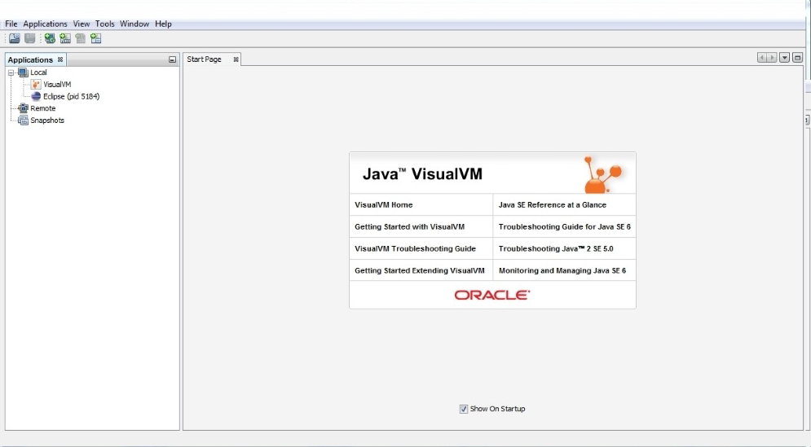
Testing and Monitoring (cont.)
VisualVM is a monitoring tool for Java.

Slide 42
Testing and Monitoring (cont.)
In the left side of the screen, we can see the Applications tab where you will see all the Java applications that are currently running by the current user in your system.
If we make a double-click in one of those applications, you will see five tabs:
Overview: shows general information about the application.
Monitor: shows graphical information about the CPU, memory, classes, and threads used by the application.
Threads: shows the evolution over time of the threads of the application.
Sampler: shows you information about the utilization of memory and CPU by the application.
Profiler: shows you information about the utilization of memory and CPU by the application.

Slide 43
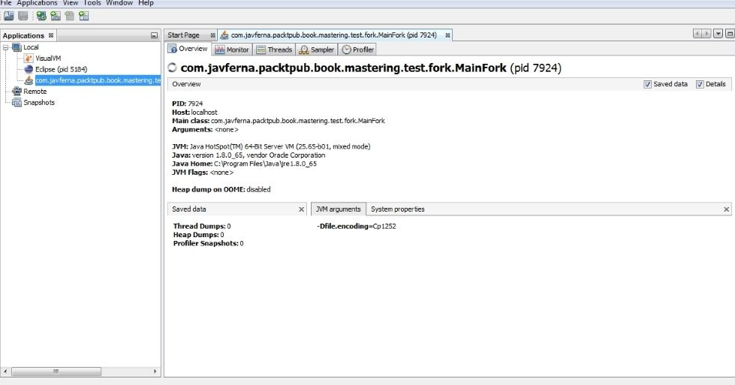
Testing and Monitoring (cont.)
Overview tab shows general information about the application.

Slide 44
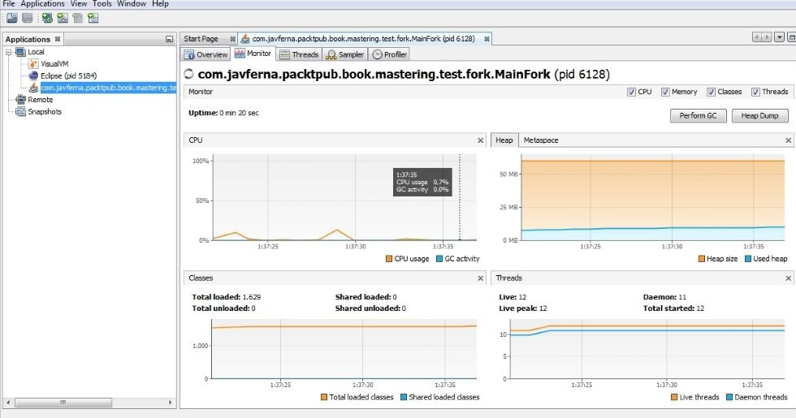
Testing and Monitoring (cont.)
Monitor tab shows graphical information about the CPU, memory, classes, and threads used by the application.

Slide 45
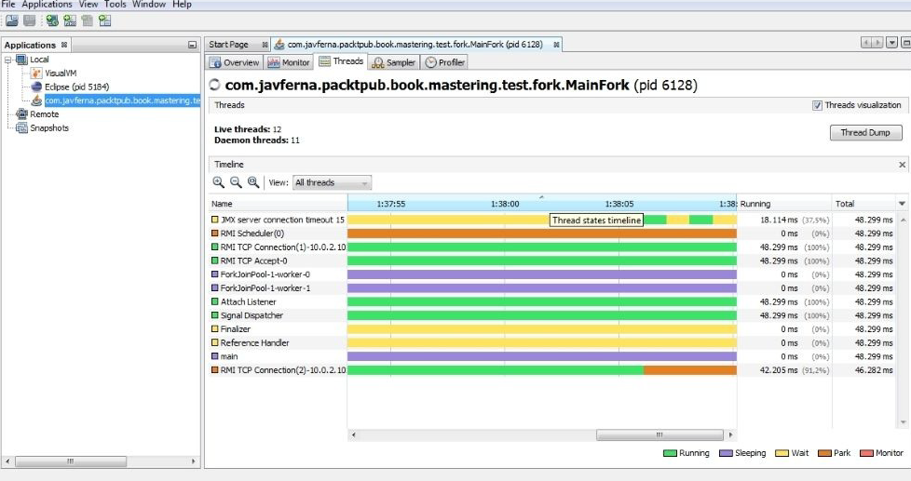
Testing and Monitoring (cont.)
Threads tab shows the evolution over time of the threads of the application.

Slide 46
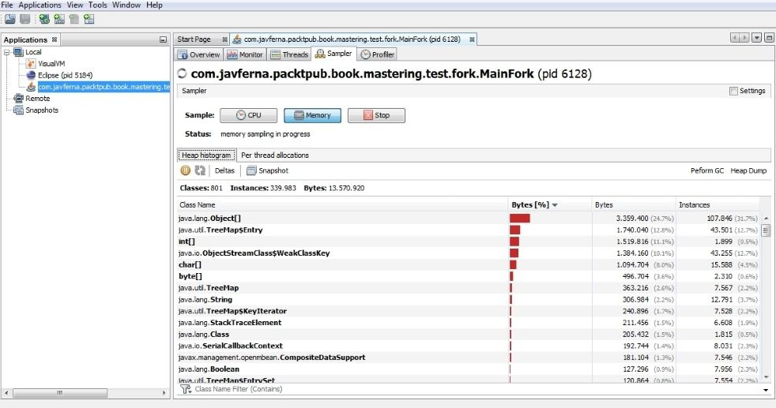
Testing and Monitoring (cont.)
Sampler tab shows you information about the utilization of memory and CPU by the application.

Slide 47
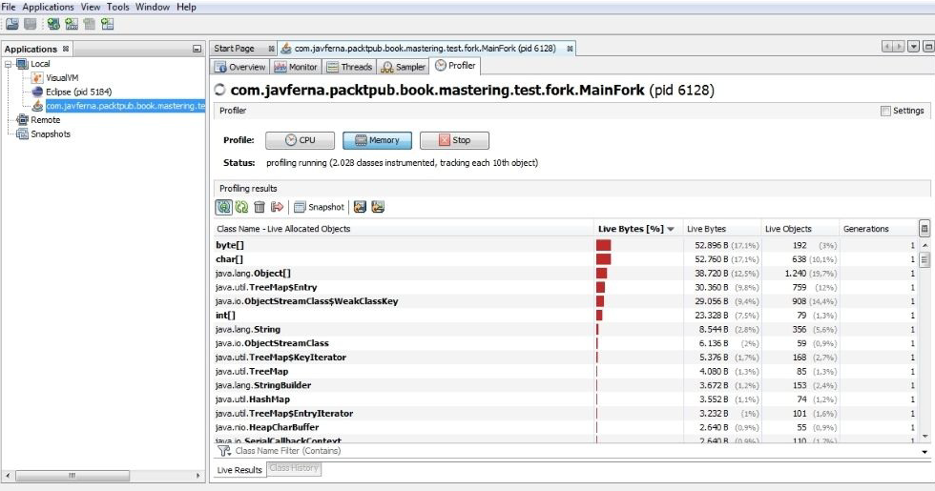
Testing and Monitoring (cont.)
Profiler tab shows you information about the utilization of memory and CPU by the application.

Slide 48

Bibliography
Mastering Concurrency Programming with Java 8

